Slide 1
Semiconductor Market Overview
February 2022
Andrea Lati
This report has been reproduced for SIA
It is approved for public release with attribution to VLSIresearch.

Slide 2
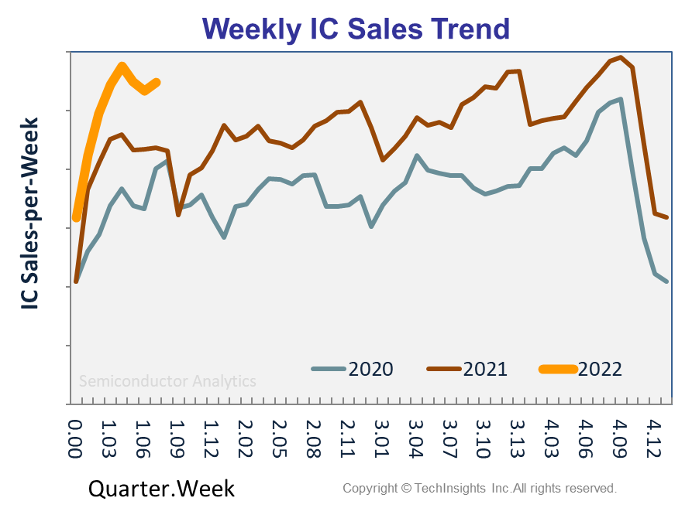
Raw IC Sales:
Raw: data has not been ‘cooked’ with a moving average or some other statistical manipulation
The week’s IC Sales:
Semiconductor sales pulled up as the shortage continued to drive demand, with record sales in the $10-12B/week range. The IC weather held at 88˚F last week.
IC Weather Report: 88˚F
  Memory: Warmer, Hot
  Foundry: Warmer, Warm
    More Moore: Cooler, Warm
    More-than-Moore: Cooled back to Sunny
  OSAT: Warmed to Hot
  IDM: Cooler, Hot
  SoC: Cooler, Warm
  Mobile: Warmer, Warm
  Analog & Power: Hotter, Hot
  Auto IC: Cooler, Hot
https://charactercounttool.com/
It marked 13 weeks straight of W/Q gains, which hasn’t happened since 2017.
Raw: data has not been ‘cooked’ with a moving average or some other statistical manipulation

Slide 3
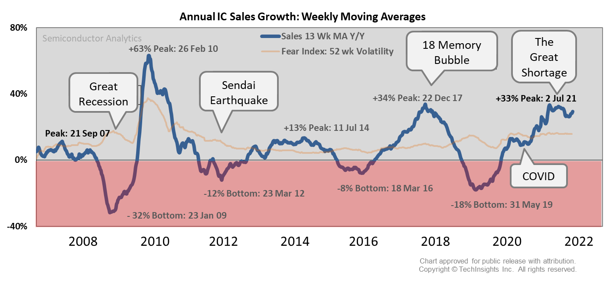
IC Sales Trend
2021 was a hot year for sales, which have been up and to the right since March of 2021, approaching $0.5T
IC growth is rolling over, but it’s still robust

Slide 4
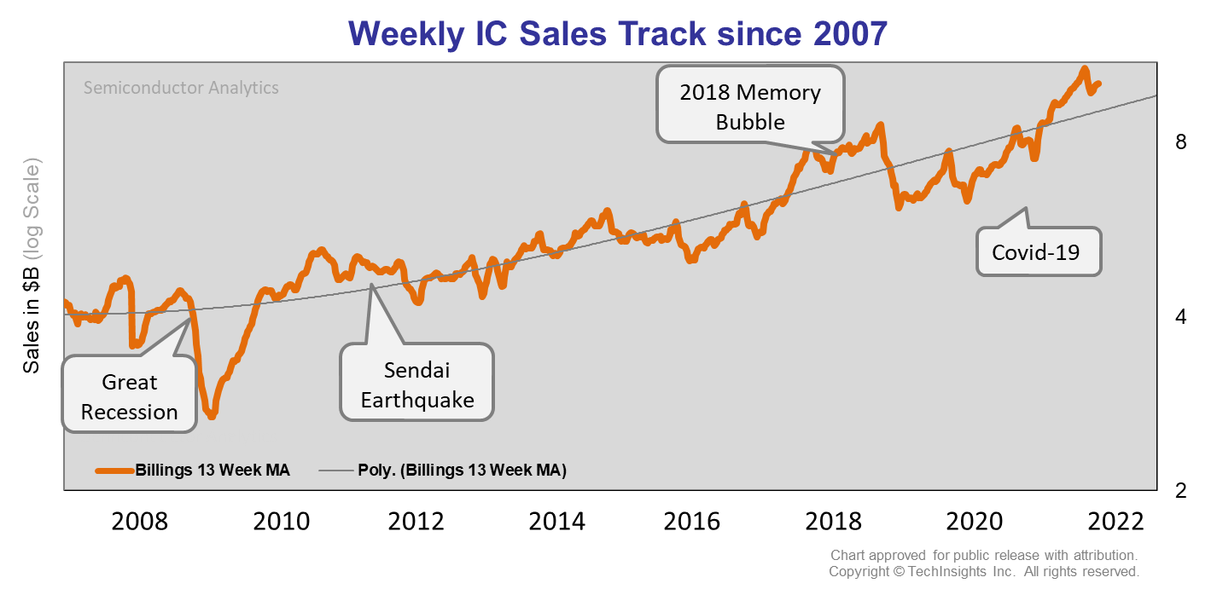
IC Sales Track: Overheated or Underheated?
IC sales have been pulling away from the trend line since April 2021 (~1 Yr)
Average up cycle 2-3 years

Slide 5
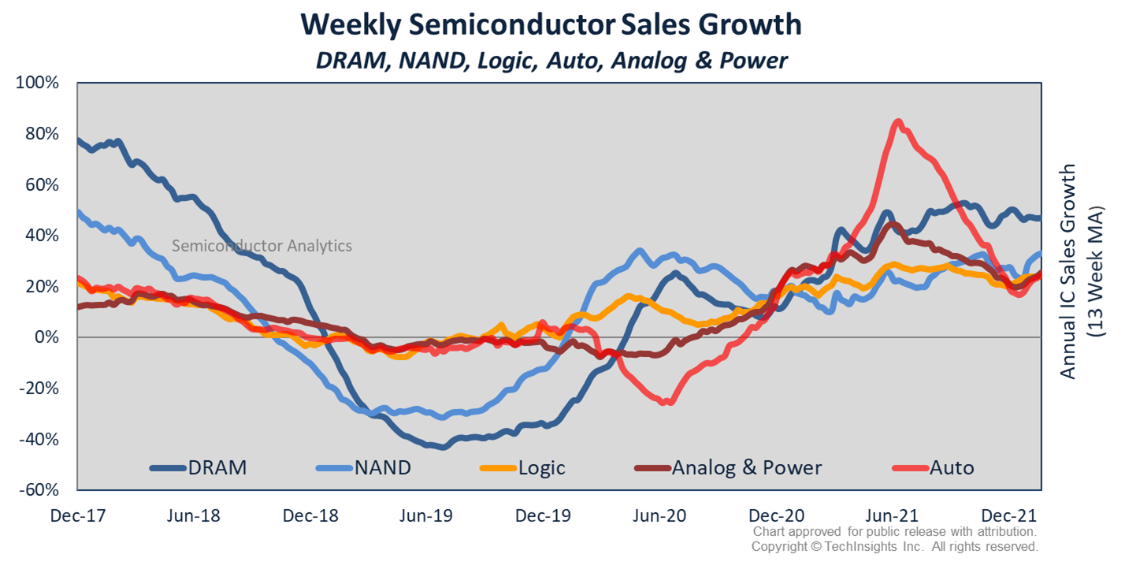
Weekly Sales Growth: DRAM, NAND, Logic, Analog & Power, and Auto
All segments closed out the year at extremely high Y/Y growth levels. Though they did cool in the year’s last weeks. The 13-wk MA growth ranged between ~15% and ~40%, with DRAM fastest and Analog & Power the slowest.
One thing that’s clear is that the Auto IC shortage peaked last summer and cooled. The same is true for A&P. Memory continues to show an upward growth trend.

Slide 6
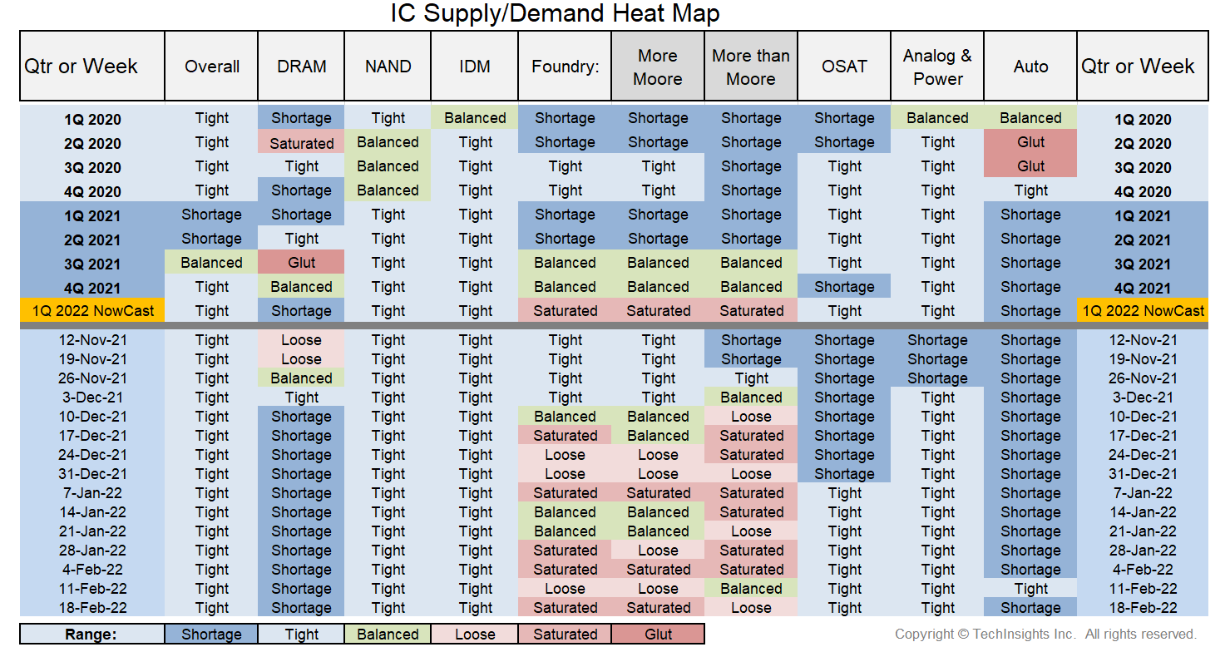
Weekly IC Supply/Demand Heat Map
Semiconductor Analytics:

Slide 7
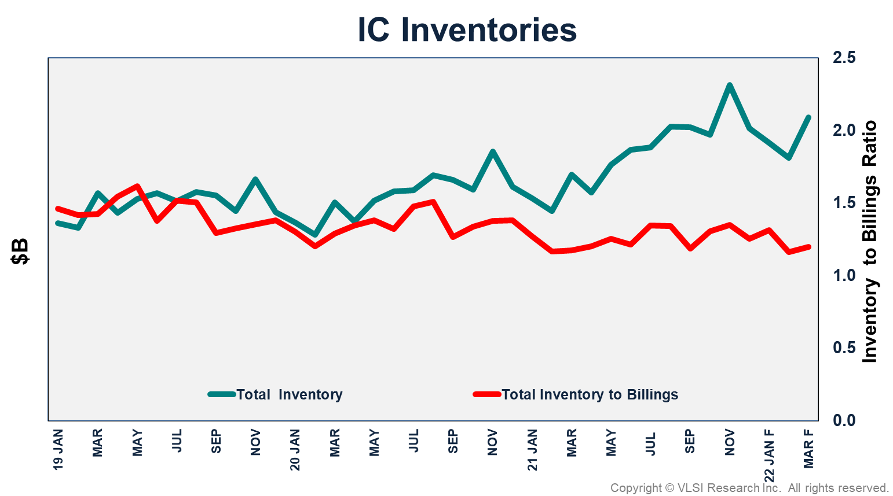
Inventories are rising, but supply is still tight
OEM IC Inventories are expanding
  Compute & Consumer running rich
Die Bank Inventories normal range
  Memory lean
  Analog, Discrete, & Power healthy
Inventories expected to remain elevated in 2022
  Shift from Just-in-time to Just-in-Case
  More inventory accumulation expected in Auto, Industrial, Networking Infrastructure
    Small portion of BOM, low-obsolescence
  Growth Driver for Auto & Industrial semiconductors in 2022

Slide 8
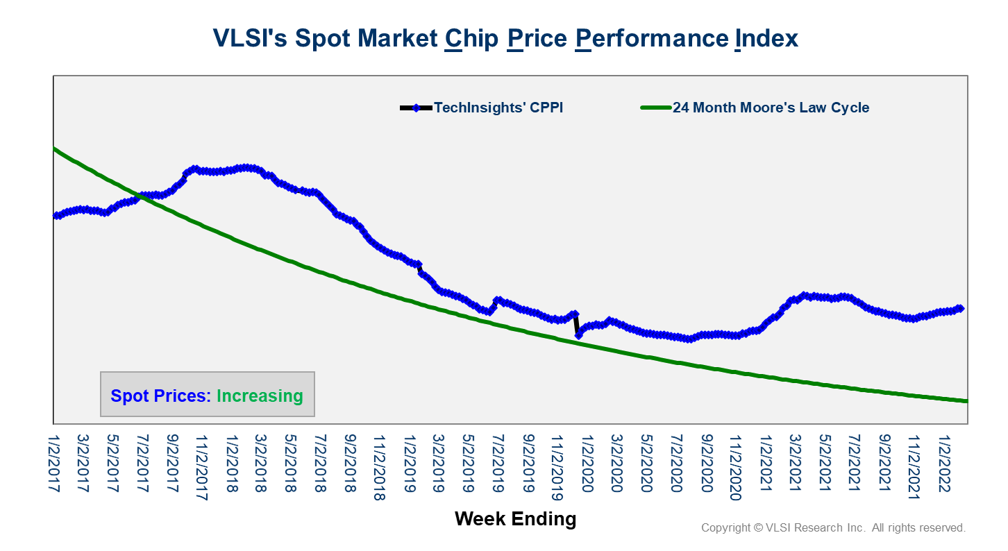
Chip Price Performance Index
The CPPI reversed course in 3Q21 and has been trending higher for nearly two months
All segments improving
Strong signal for 2022 prospects

Slide 9
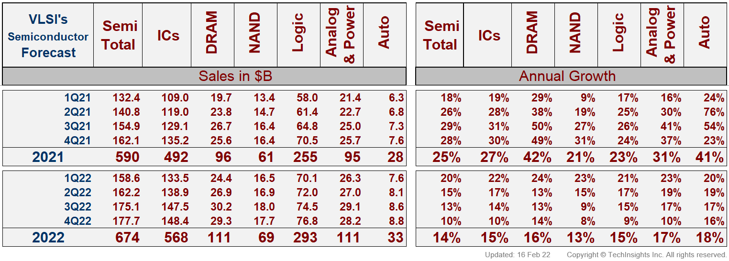
WW Semiconductor Forecast: DRAM, NAND, Logic, Analog & Power, and Auto

Slide 10
Capex
Capex remained highly concentrated at the top
  Top 6 accounted for >75% in 2021
Five Chinese companies in the top 16 accounting for 9% of spending last year, down from 13% in 2020

Slide 11
New Investment Activities:
Over in $120B in new investments in the next two years

Slide 12
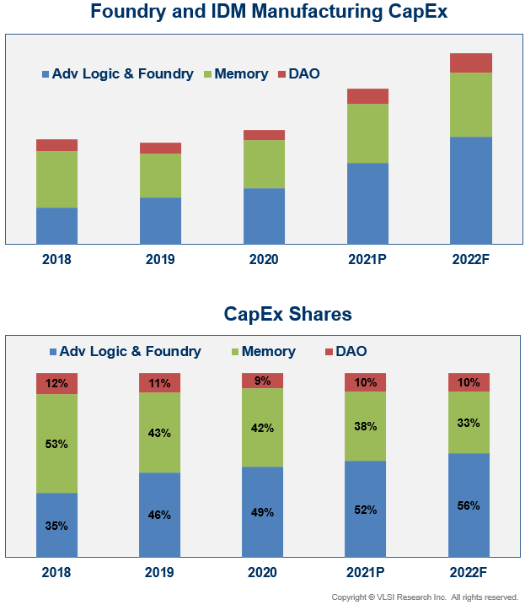
Capex by Application
Adv.Logic/Foundry will be the fastest growing segment for the 4th consecutive year
Capital intensity pendulum has swung from Memory to Adv. Logic
  3D NAND to EUV

Slide 13
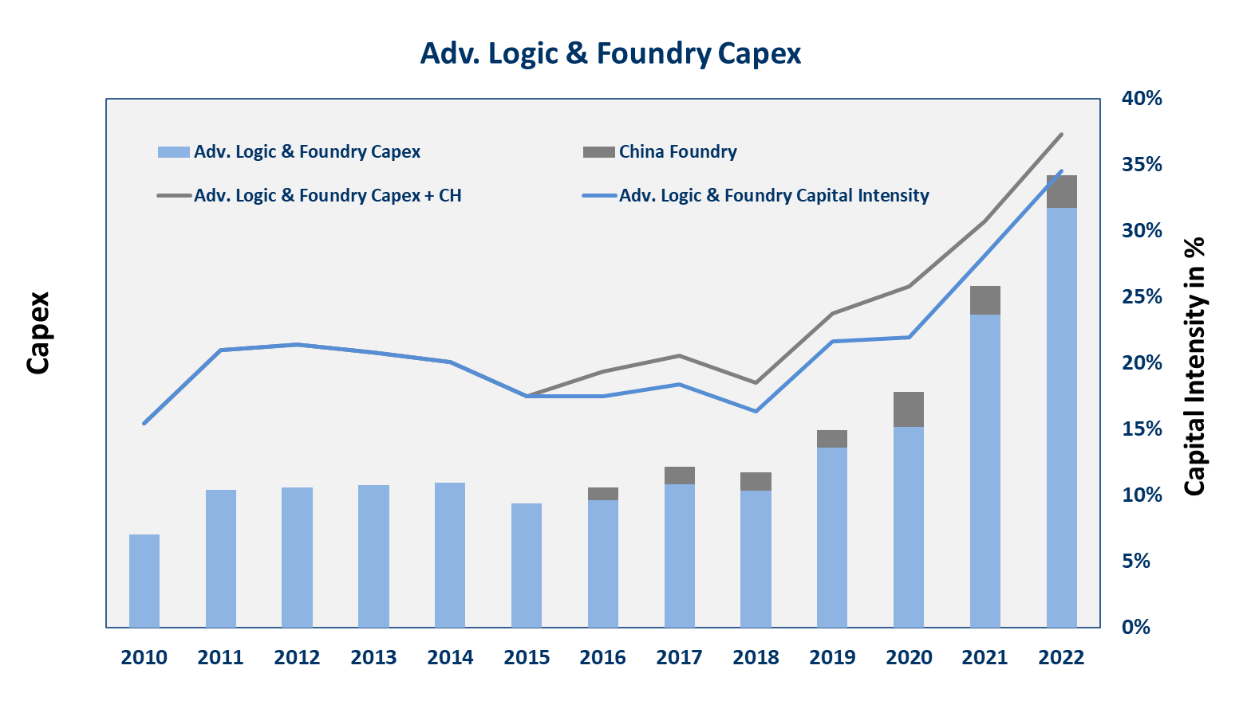
Adv. Logic & Foundry
Capex hit $78B in 2021
  Up 45% YoY
  China down ~20% due to SMIC’s restrictions
2022 Capex expected to increase 32%
  Driven by Intel, TSMC, GF

Slide 14
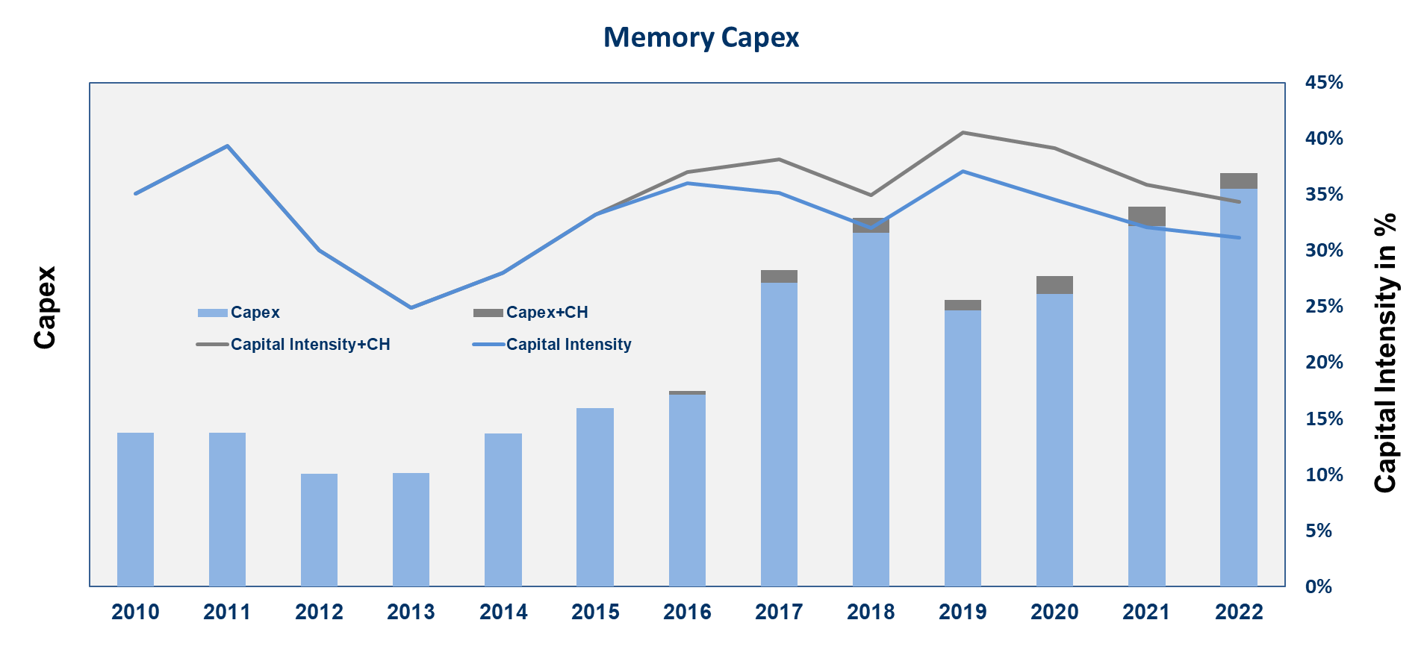
Memory Capex
Memory Capex increased 22% in 2021
Still below 2018 levels
Memory spending expected to hit $61B in 2022, up 9%
Spending levels are healthy

Slide 15
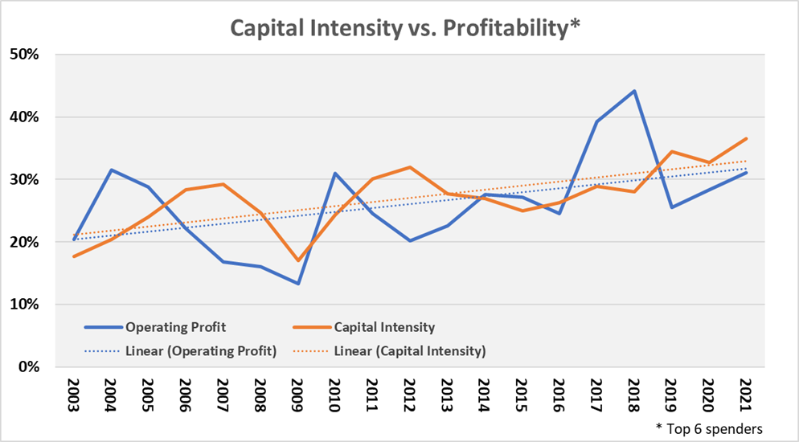
Is the rising capital intensity sustainable?
Increasing capital intensity has been supported by increased profitability

Slide 16
Forecast Summary

Slide 17

Thank You
Get TechInsights’s ChipChirps™ and Semiconductor WEEK
by downloading TechInsights’s App for Android and iOS:

Slide 18
Terms and Conditions, Notices, and Disclaimers, etc.
For public panels and allows public release with attribution & limited use — remove this text box upon selection of T&C slide.
By accepting this report, opening it, or using it you are agreeing to these terms This report contains valuable data, intellectual property, and trade secrets developed or acquired by TechInsights. You have a limited license to hold these materials but do not become the owner of any material. The materials provided are protected by copyright, trade secret, and trademark law. This presentation has been approved by TechInsights for public release with attribution. The information in the materials may be used by you on a limited basis in your own documents provided that those documents are not-for-sale; TechInsights’ name, brand, or trademarks are not used to endorse a product or company for sales purposes; TechInsights is clearly referred to as the source of such information; and you obtain written approval prior to use.
This report is provided on an "AS IS," "WHERE IS", "WHERE AVAILABLE", “WITH ALL FAULTS” basis. TechInsights does not warrant these materials or the information provided therein, either expressly or impliedly, for any particular purpose and TechInsights specifically disclaims any express or implied warranties, including but not limited to, any express or implied warranties of TITLE, ACCURACY, NON-INFRINGEMENT, MERCHANTABILITY or FITNESS FOR ANY PARTICULAR PURPOSE OR USE.
This report was generated based upon the views and opinions of the moderator and panelists. These views and opinions are personal views and may not be the views and opinions of their employers.
This report may contain information concerning stocks that is obtained from the opinions of industry analysts. Quoted past results are not necessarily indicative of future performance. None of the information should be seen as a recommendation to buy or sell any securities. We are not stock analysts or investment advisors. You should contact a registered investment advisor as to the nature, potential, value or suitability of any particular investment action. No information provided is investment advice and any such information is just an opinion and is not tailored to the investment needs of any specific person. Certain statements in this report, other than statements of historical fact, and other written or oral statements made by TechInsights may be forward-looking. In some cases, you can identify forward-looking statements by terminology such as "may", "will", "should", "expects", "intends", "plans", "anticipates", "believes", "thinks", "estimates", "seeks", "predicts", "potential", and similar expressions. Although TechInsights believes that these statements are based on reasonable assumptions, they are subject to numerous factors, risks and uncertainties that could cause actual results and outcomes to be materially different from those stated or projected. Those factors, among others, could cause actual results and outcomes to differ materially from the results and outcomes stated or projected in, or implied by, the forward-looking statements. You should understand that forward-looking statements are not guarantees of results or outcomes. New risks and uncertainties arise from time to time, and TechInsights can not predict those events or how they may affect you, the reader. TechInsights Inc does not have any intention or obligation to update forward-looking statements after the date of this report.
No part of this report may be used in any legal proceedings nor may any of these materials or the information contained therein be disclosed to any third party, including investors or affiliated firms belonging to investors, outside directors or to your affiliated companies, or reproduced or transmitted to any third party, in any form or by any means – mechanical, electronic, photocopying, duplication, microfilming, videotape, verbally or otherwise – without the prior written permission of TechInsights.
The Chip Insider® and the CSS 10 BEST logo are registered trademarks of TechInsights Inc. All other trademarks, service marks, and logos are the property of their respective owners.

